Slide 1
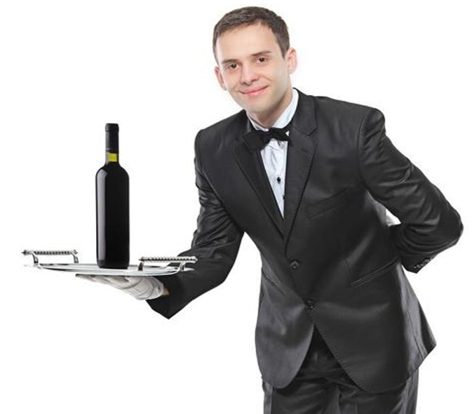
The Waiter robot
김민우

Slide 2
contents
Introduction
The goal of robot
Based theory
Challenge
Simulation in matlab

Slide 3
introduction
This program will show the movement of general robot waiter.

Slide 4
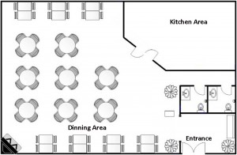
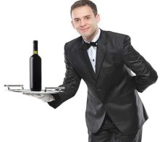
The goal of project
When the customer presses the call button, the robot computes the optimal path, and moves to customer. If they have more than one order, the robot processes the order by FIFO(First In First Out).
If the battery is low, the robot moves to the charging station.

Slide 5
based theory
1. A* algorithm & Dynamic programming
computing the optimal path from start to goal.
2. Smoothing algorithm
minimize the path between realistic path & optimal path.
3. PID control
implement the real action of robot.
4. Particle & Bayes filter
the probability distribution of location When the robot actually works.
5. QUEUE- save the order in QUEUE.

Slide 6
challenge
If the new obstacle appear, the robot should choose another path.
If the map has been changed, the robot should compute the optimal path again. Ex) When the customer moves the table.
If the shape of table is circle, The robot should draw the curved line to get to the goal.

Slide 7
Simulation in matlab

Slide 8
Thank you^^

